Slide 1

How has climate change influenced US weather statistics?

Slide 2
The Purpose
Climate change is a ubiquitous topic all around the world
Main Questions:
Is there a statistically significant difference between recent weather data and weather data collected decades ago?
Does a correlation exist between the climate development in different selected US cities
Can negative developments as droughts be predicted with the available data?

Slide 3
The Process
After selecting the topic, the available data was easy to find
High number of qualitative datasets available
Found two well-apt csv files for hypothesis tests and regression
Analysis in Google Colab
→ Straight-forward data analysis

Slide 4
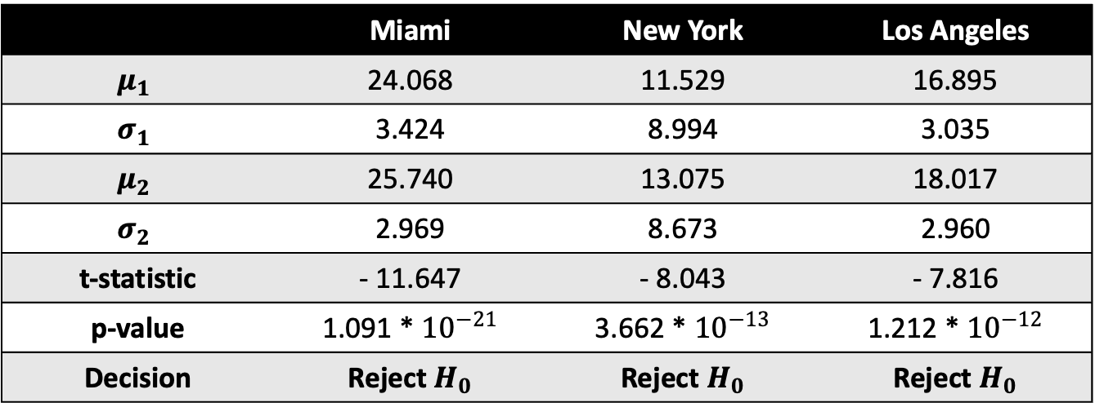
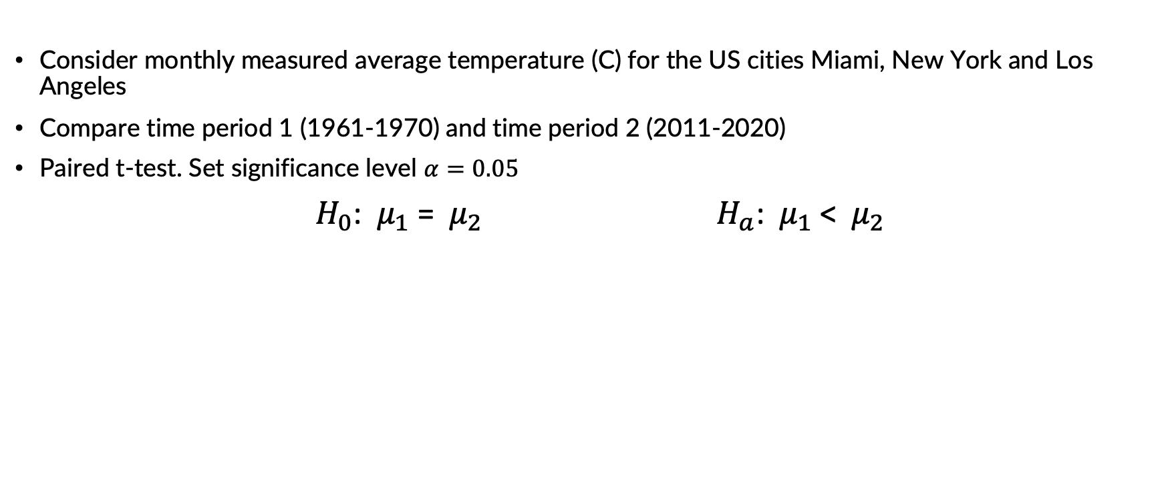
Mean Average Temperature for Individual US Cities
Consider monthly measured average temperature (C) for the US cities Miami, New York and Los Angeles
Compare time period 1 (1961-1970) and time period 2 (2011-2020)
Paired t-test. Set significance level $α=0.05$
$H_{0}$: $μ_{1}$ = $μ_{2}$ $H_{a}$: ${ μ}_{1}$ < ${ μ}_{2}$
 | Miami | New York | Los Angeles
$$μ_{1}$$ | 24.068 | 11.529 | 16.895
$$σ_{1}$$ | 3.424 | 8.994 | 3.035
$$μ_{2}$$ | 25.740 | 13.075 | 18.017
$$σ_{2}$$ | 2.969 | 8.673 | 2.960
t-statistic | - 11.647 | - 8.043 | - 7.816
p-value | 1.091 * ${10}^{−21}$ | 3.662 * ${10}^{−13}$ | 1.212 * ${10}^{−12}$
Decision | Reject $H_{0}$ | Reject $H_{0}$ | Reject $H_{0}$

Slide 5
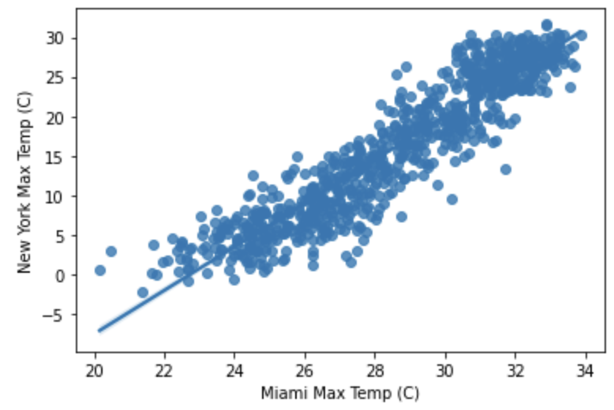
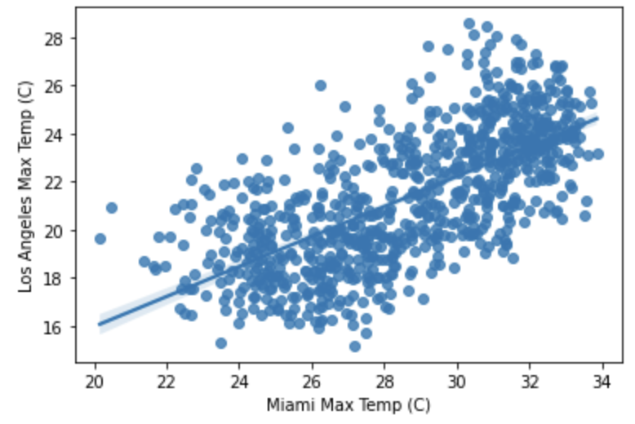
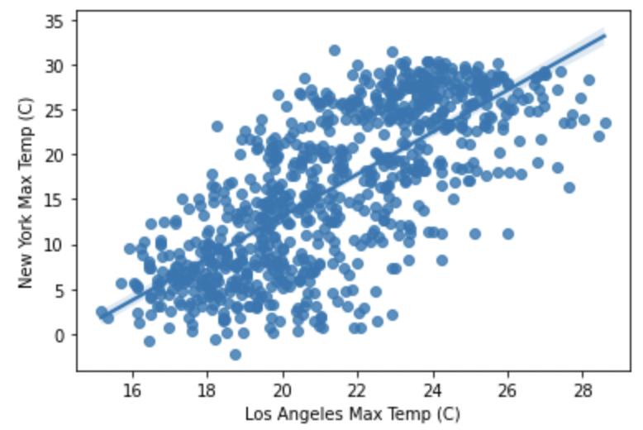
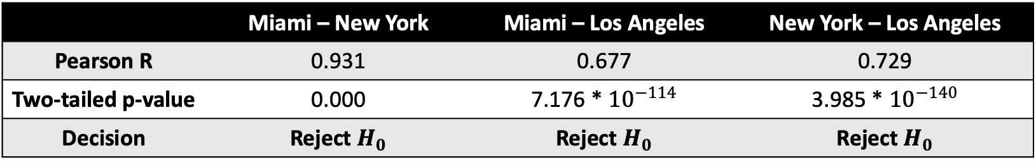
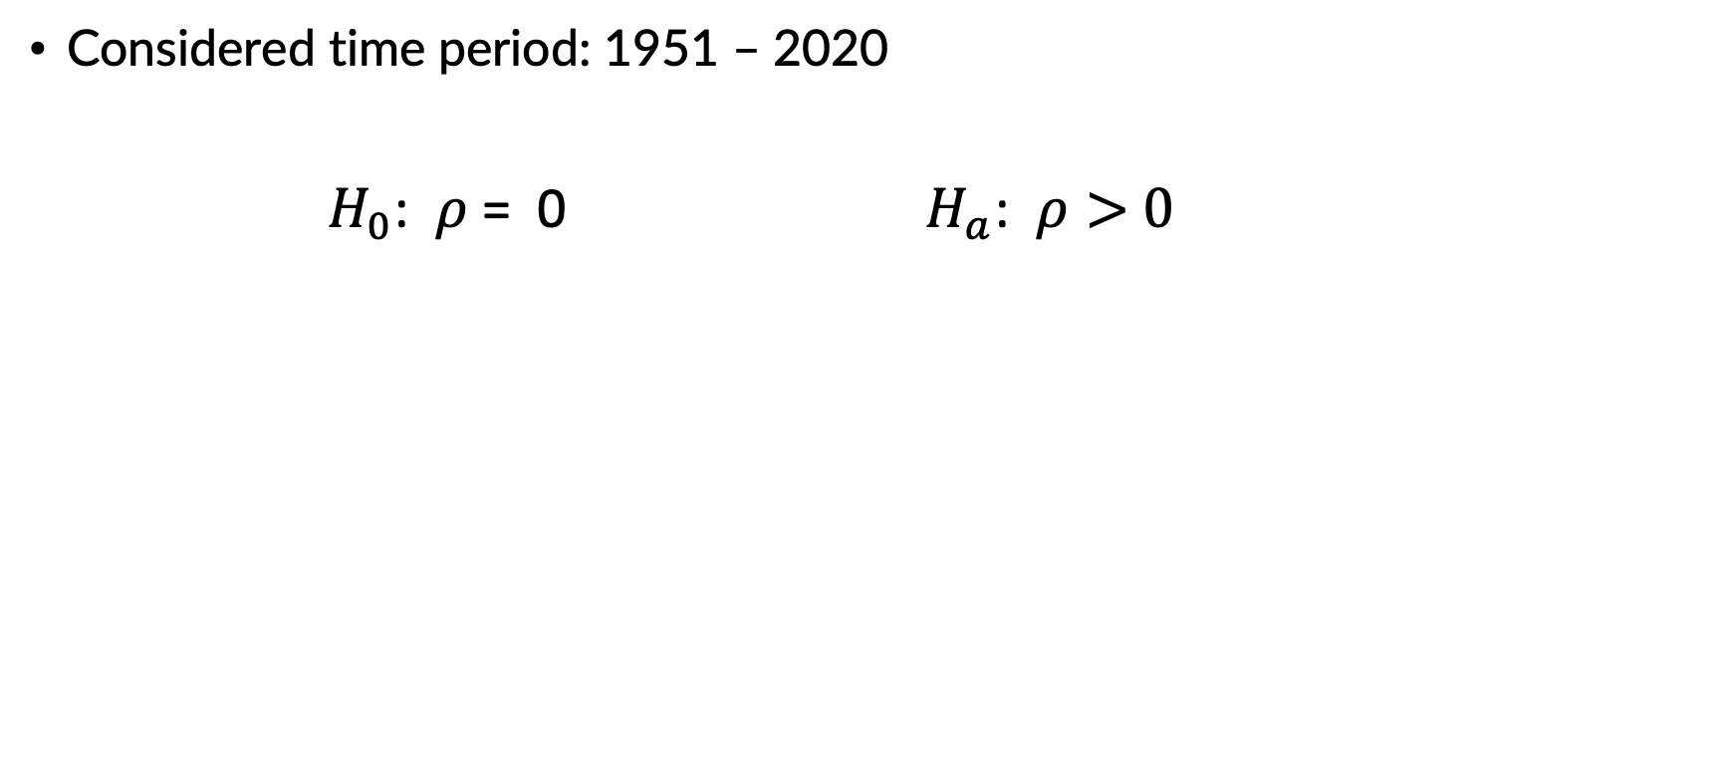
Correlation of Maximum Temperature for Individual Non-US Cities
Considered time period: 1951 – 2020
$H_{0}$: $ρ$= 0 $H_{a}$: $ρ>$ $0$
 | Miami – New York | Miami – Los Angeles | New York – Los Angeles
Pearson R | 0.931 | 0.677 | 0.729
Two-tailed p-value | 0.000 | 7.176 * ${10}^{−114}$ | 3.985 * ${10}^{−140}$
Decision | Reject $H_{0}$ | Reject $H_{0}$ | Reject $H_{0}$

Slide 6
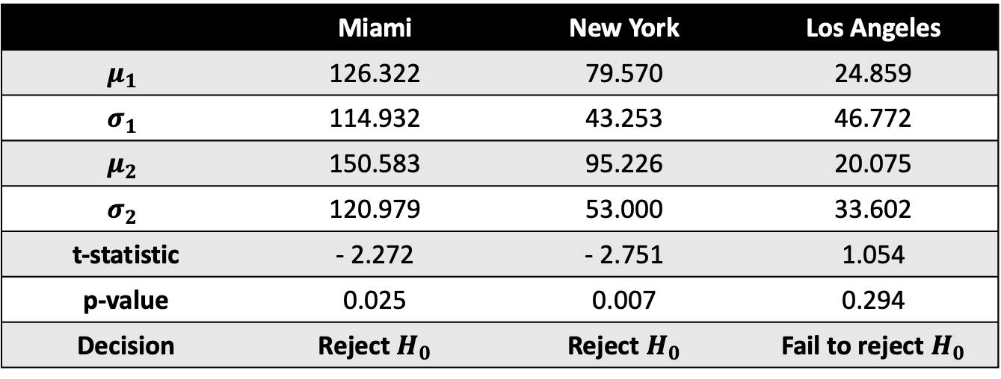
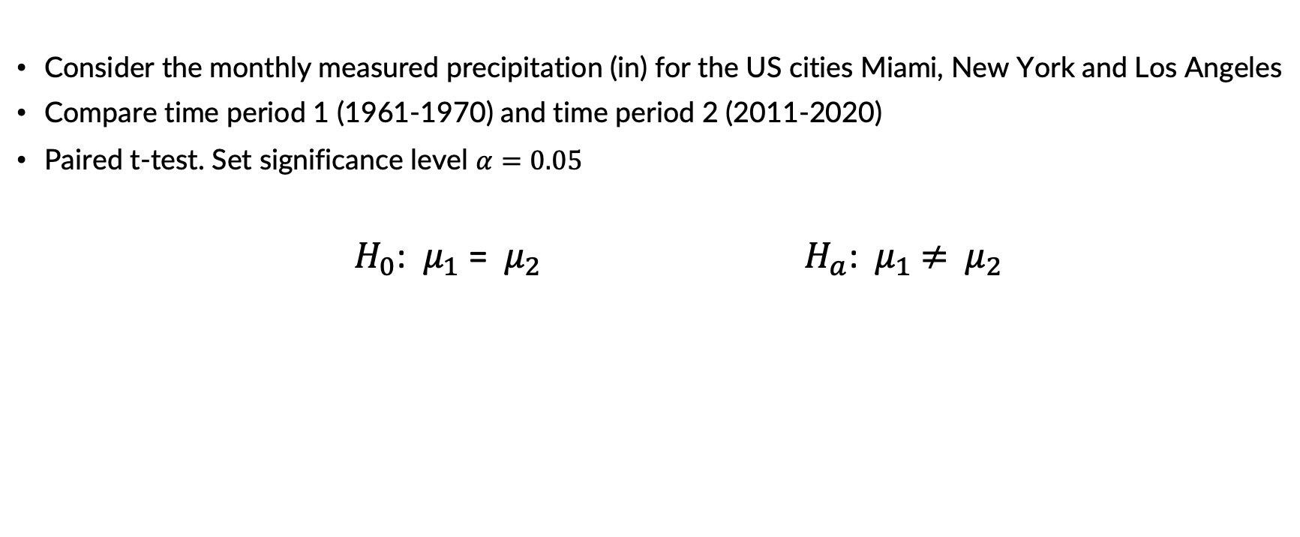
Precipitation for Individual US Cities
Consider the monthly measured precipitation (in) for the US cities Miami, New York and Los Angeles
Compare time period 1 (1961-1970) and time period 2 (2011-2020)
Paired t-test. Set significance level $α=0.05$
$H_{0}$: $μ_{1}$ = $μ_{2}$ $H_{a}$: ${ μ}_{1}$ $≠$ ${ μ}_{2}$
 | Miami | New York | Los Angeles
$$μ_{1}$$ | 126.322 | 79.570 | 24.859
$$σ_{1}$$ | 114.932 | 43.253 | 46.772
$$μ_{2}$$ | 150.583 | 95.226 | 20.075
$$σ_{2}$$ | 120.979 | 53.000 | 33.602
t-statistic | - 2.272 | - 2.751 | 1.054
p-value | 0.025 | 0.007 | 0.294
Decision | Reject $H_{0}$ | Reject $H_{0}$ | Fail to reject $H_{0}$

Slide 7

Regression: Predicting Droughts Significance level $α=0.05$
The Dataset provides the following columns (time period 2017 – 2018):
General / Soil data | Measured at 2 meters | Measured at 10 meters | Measured at 50 meters
Drought Score | Humidity | Average Wind Speed | Average Wind Speed
Fips county code | Average Temperature | Max Wind Speed | Max Wind Speed
Date | Dew/Frost Point | Min Wind Speed | Min Wind Speed
Precipitation | Wet Bulb Temperature | Wind Speed Range | Wind Speed Range
Surface Pressure | Max Temperature
Earth Skin Temperature | Min Temperature
 | Temperature Range

Slide 8
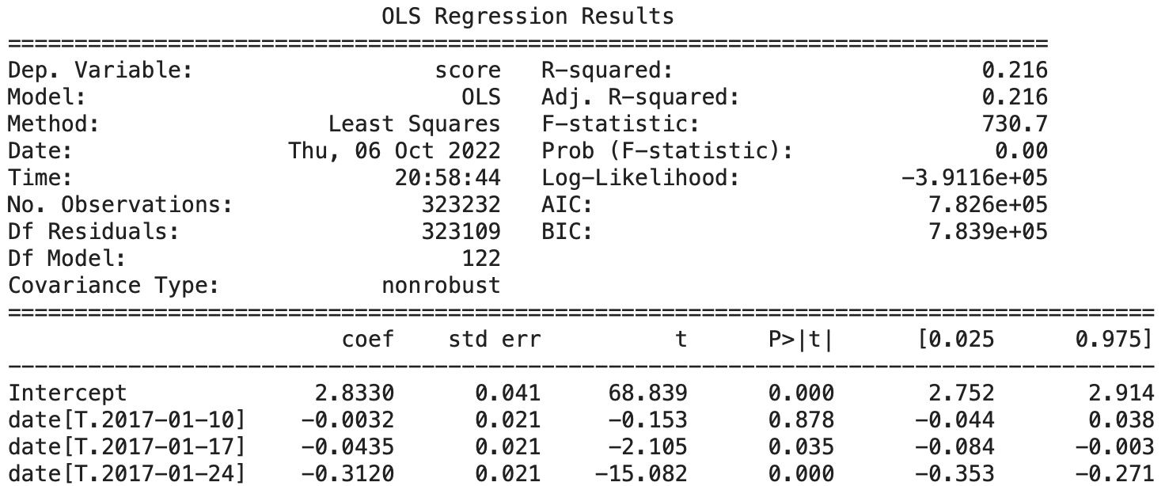
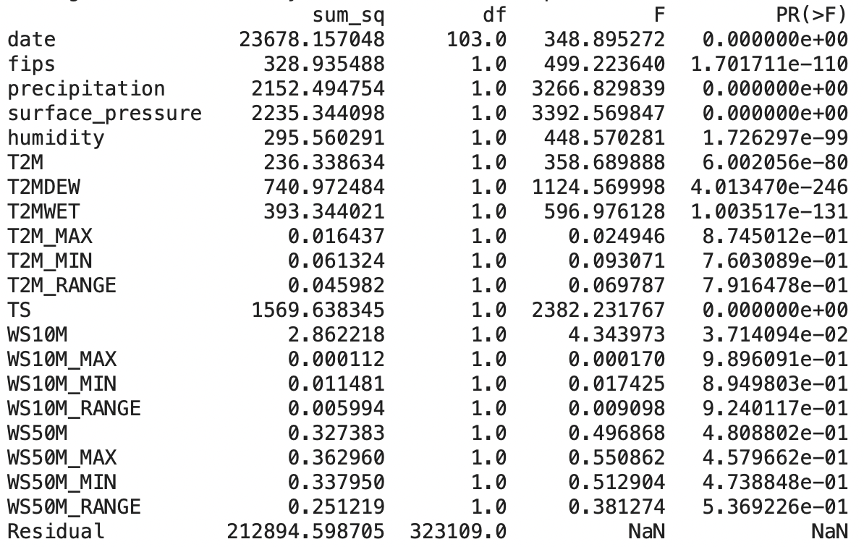
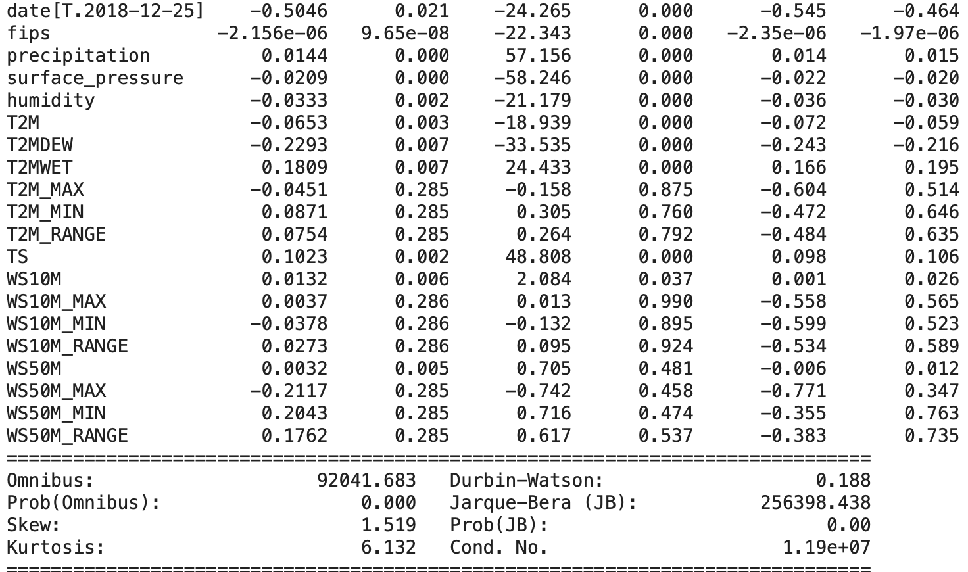

First Approach: Using all the Parameter Columns
Score = $a_{0}+a_{1}$ * fips $+ a_{2}$ * date $+…+a_{20}$ * WS50M_RANGE

Slide 9
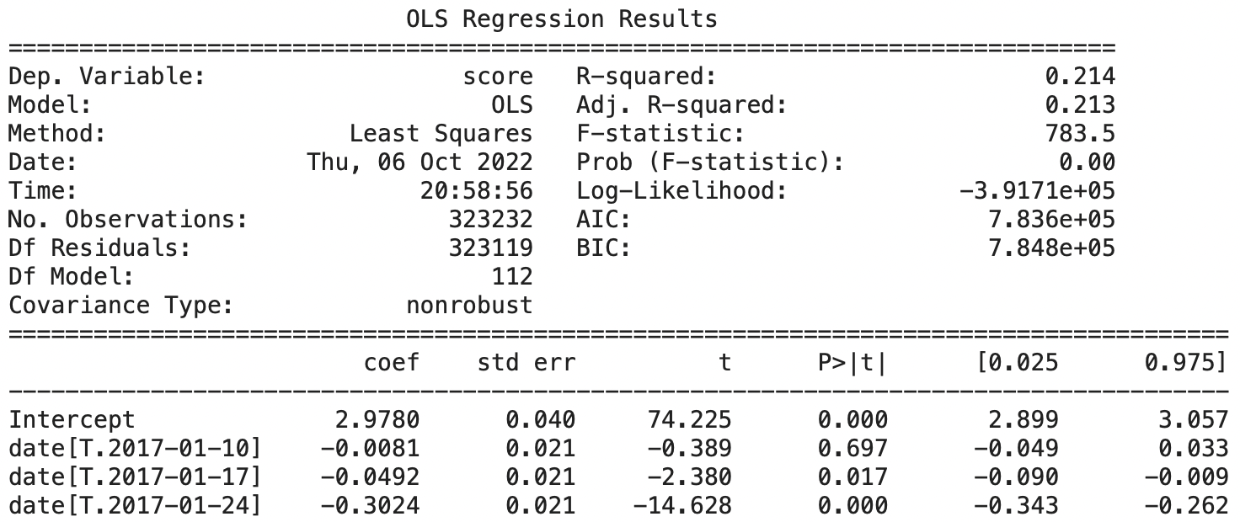
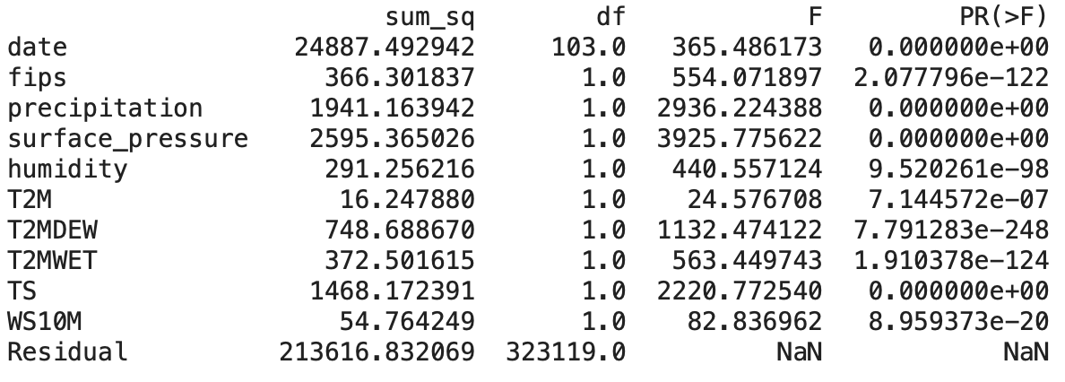
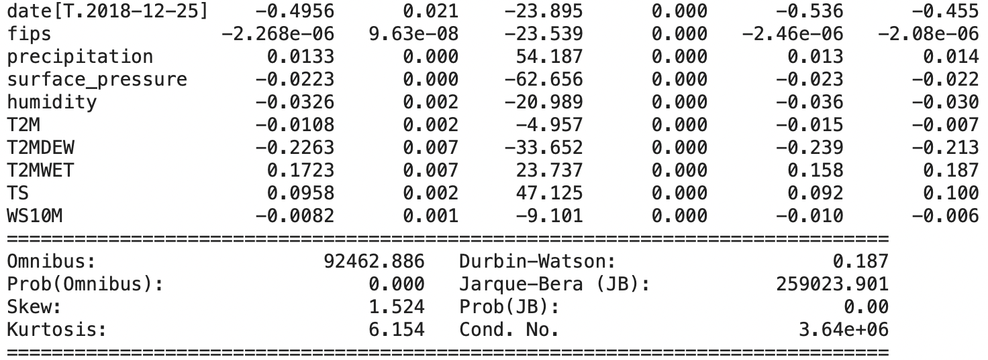


Second Approach: Refine the model
Eliminate all parameters with $p−value<0.05$
Score = $a_{0}+a_{1}$ * fips $+ a_{2}$ * date $+…+a_{10}$ * WS10M

Slide 10
Sources
https://www.ncei.noaa.gov/access/search/data-search/daily-summaries?bbox=25.856,-80.279,25.694,-80.117
https://www.kaggle.com/datasets/cdminix/us-drought-meteorological-data

